Slide 1
Cloud Infrastructure for Portable AI Milestone
Nathan Dolbir, Kennedy Fairey, Anirudh Oruganti

Slide 2
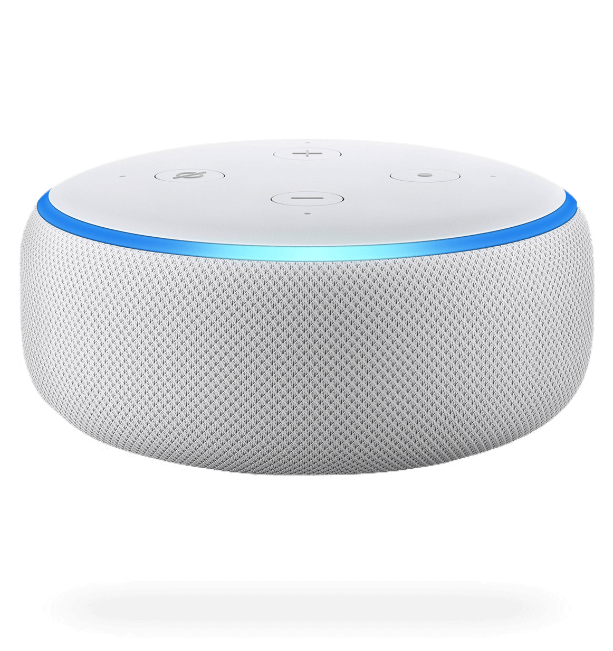
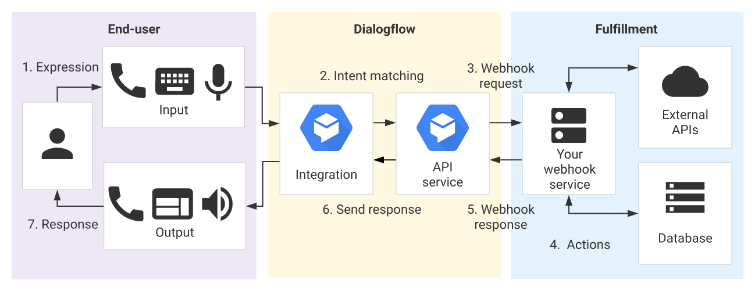
Our Mission
To prove individual developers can create powerful ML systems on portable devices using cloud computing
This has been done by large corporations, but not on an individual and small development basis
Alexa, the cloud ML industry standard.
Dialogflow abstracts ML into an API rather than provide a way to implement your own models

Slide 3
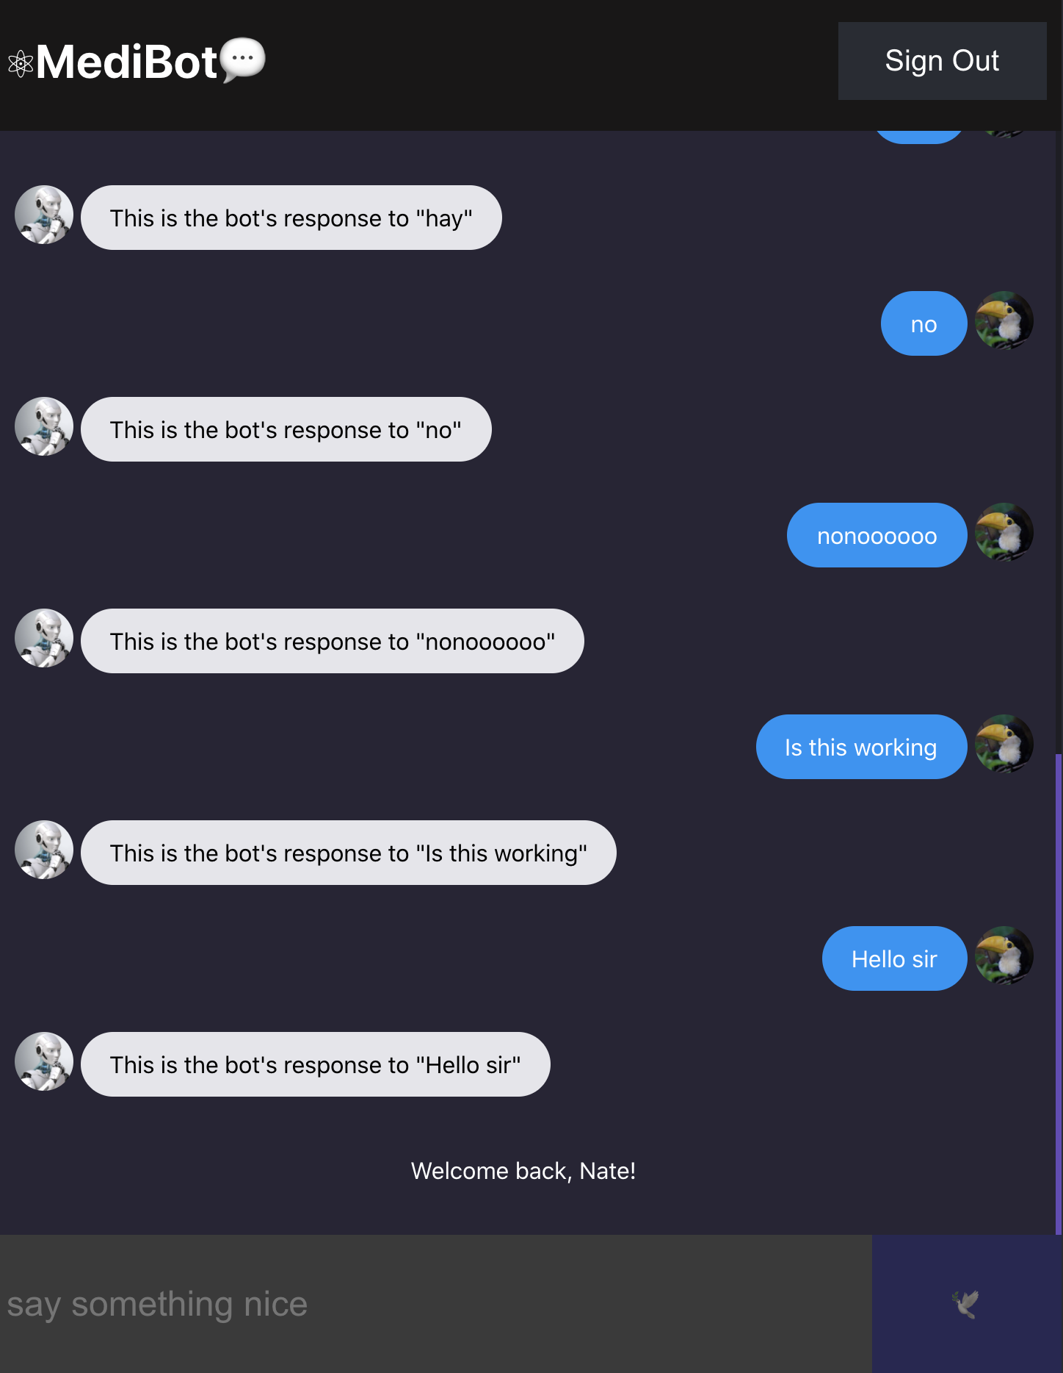
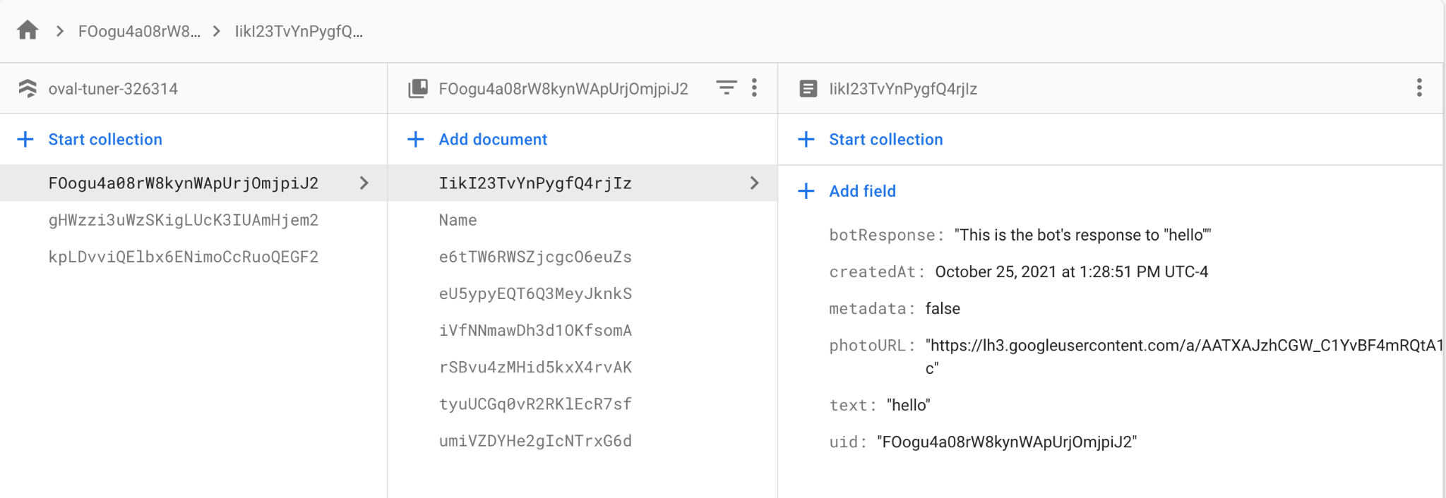



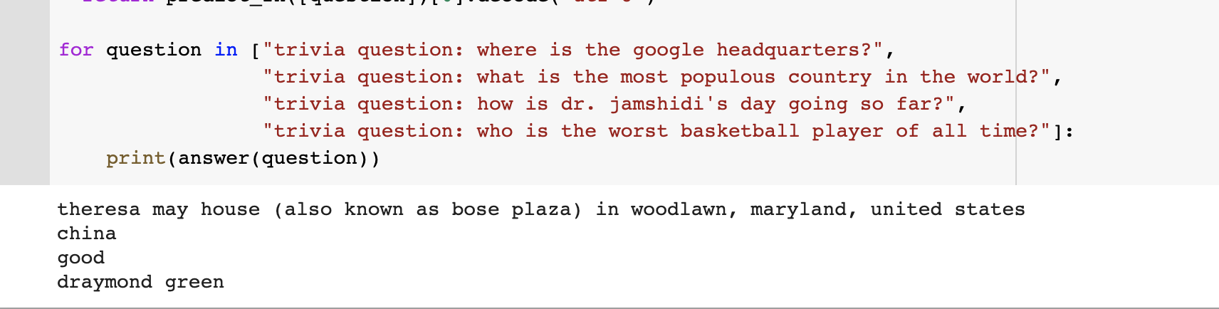

Project Status
Infrastructure
End to end data pipeline
Cloud Models -> Firebase -> Frontend UI
<UI/>
Firestore DB (JSON)

Slide 4
Progress
Our first goal is to implement our end to end infrastructure with an already functioning model (T5 Transformer Model)
This model answers any type of trivia question
Model has been deployed in GCP
UI is functional and has been deployed
Need to completely connect backend to frontend

Slide 5
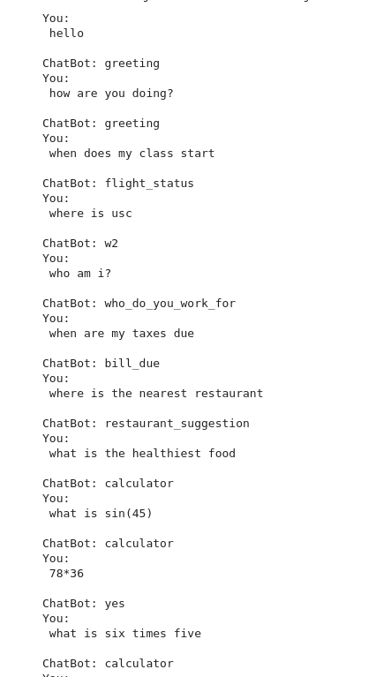
Project Status
Chatbot Models
Term Frequency - Inverse Document Frequency (TF-IDF)
Text to Text Transfer Transformer (T5)
T5 Model using Colab Notebook, stored in Cloud
TF-IDF for sequence classification

Slide 6
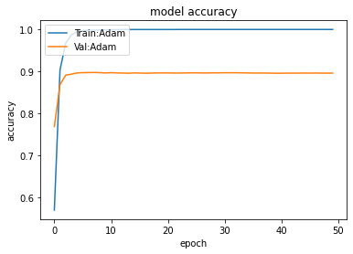
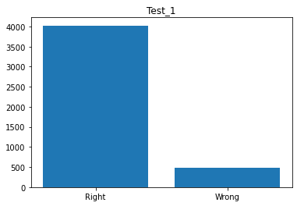
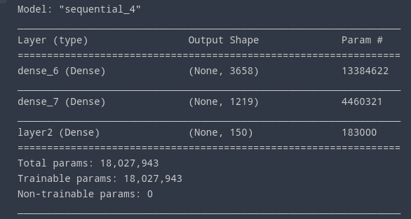
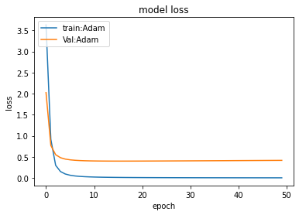
About the TF-IDF Model
Built using Sklearn and Keras Api.
Uses Bag-of-Words approach for vectors.
Uses “Tanh” Activation Layer.
Uses Adam Optimizer
Model Accuracy Graph using Adam Optimizer
Number Correct and Incorrect Intent Prediction of 4500 Sentence Data Set
Model Loss Graph using Adam Optimizer
Model Summary

Slide 7
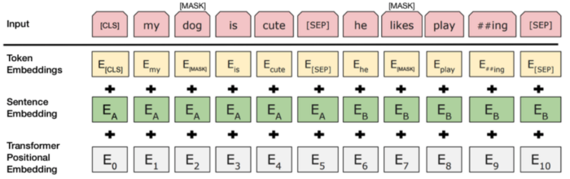
Bert Model
BERT (Bidirectional Encoder Representations from Transformers) is state-of-the-art model made by Google that specializes in NLP tasks such as q&a based on text, classification tasks like sentimental analysis, etc.
Text is processed bidirectional unlike RNN using a single directional sequence either from left to right or right to left, it encodes entire text at once.
State-of-Art model results can be easily achievable via fine tuning pre-trained bert this model.

Slide 8
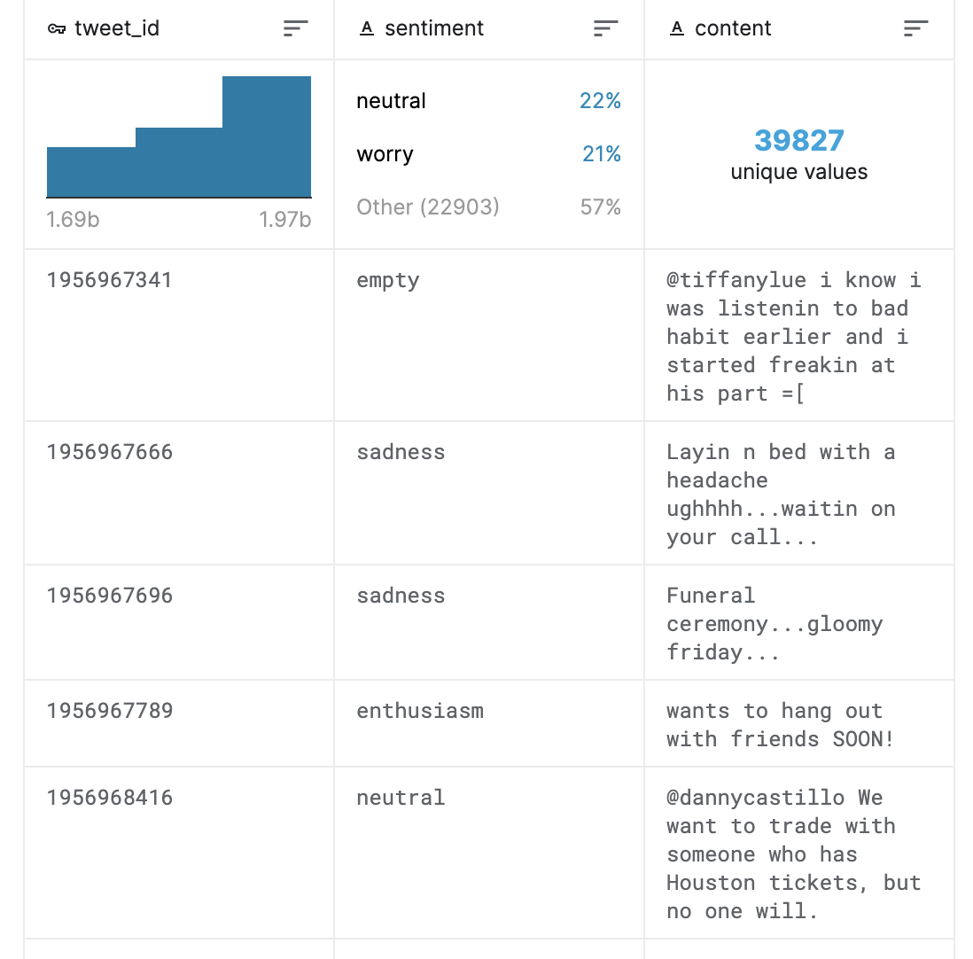
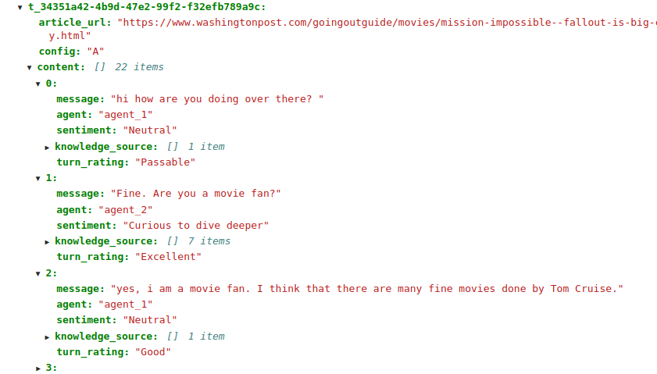
Models Plan
Sentiment classifier (TF-BERT for Sequence Classification)
Simple BERT with different dataset
Conversational Response (TF Transformer)
Sequence to sequence Transformer
Given classification matrix and blank sentence, fill sentence with dataset words assuming the classification
Dataset for sentiment classification

Slide 9
Progress
Our next goal is to seemingly combine both of our preliminary models into a singular functioning model
Ideally it will answer any trivia question and also be conversational
Once the UI is connected to the T5 model and our chatbot is correctly predicting what to say, then we can integrate our new datasets and re-train

Slide 10
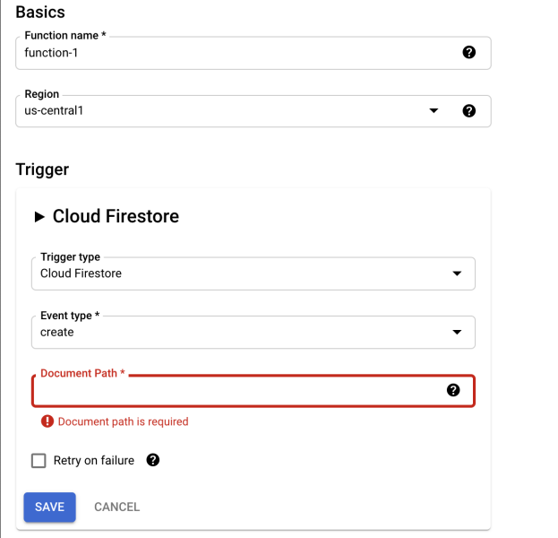
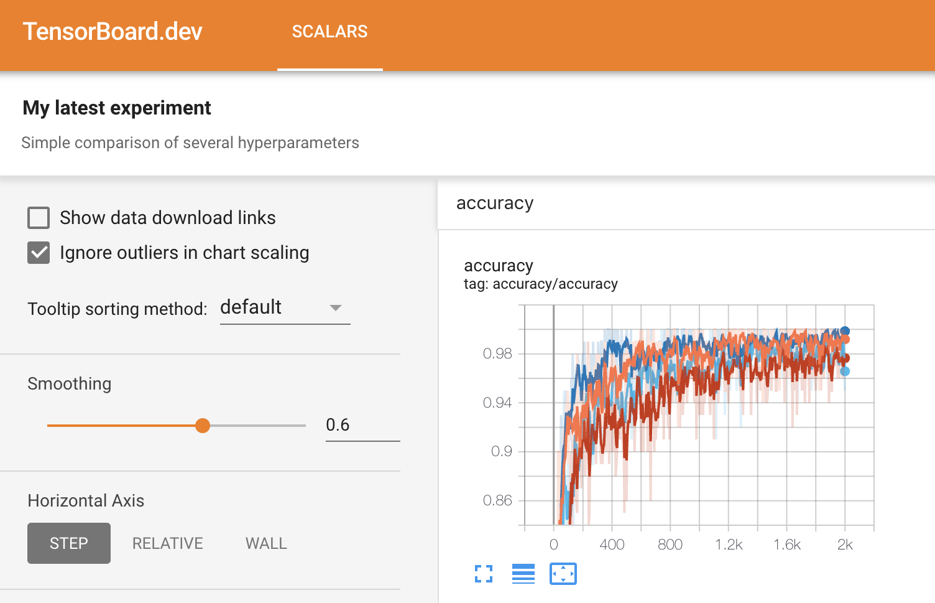
Project Tribulations and Goals
Create Cloud Functions
Create BERT Classifier and Transformer Seq2Seq models, integrate and deploy
Heavy workload on DB-cloud involved
Polish UI, test on phone
TensorBoard Model Evaluation
Cloud Analytics for Infrastructure

Slide 11
References
https://proceedings.neurips.cc/paper/2017/file/3f5ee243547dee91fbd053c1c4a845aa-Paper.pdf
https://ai.googleblog.com/2020/02/exploring-transfer-learning-with-t5.html

